Slide 1
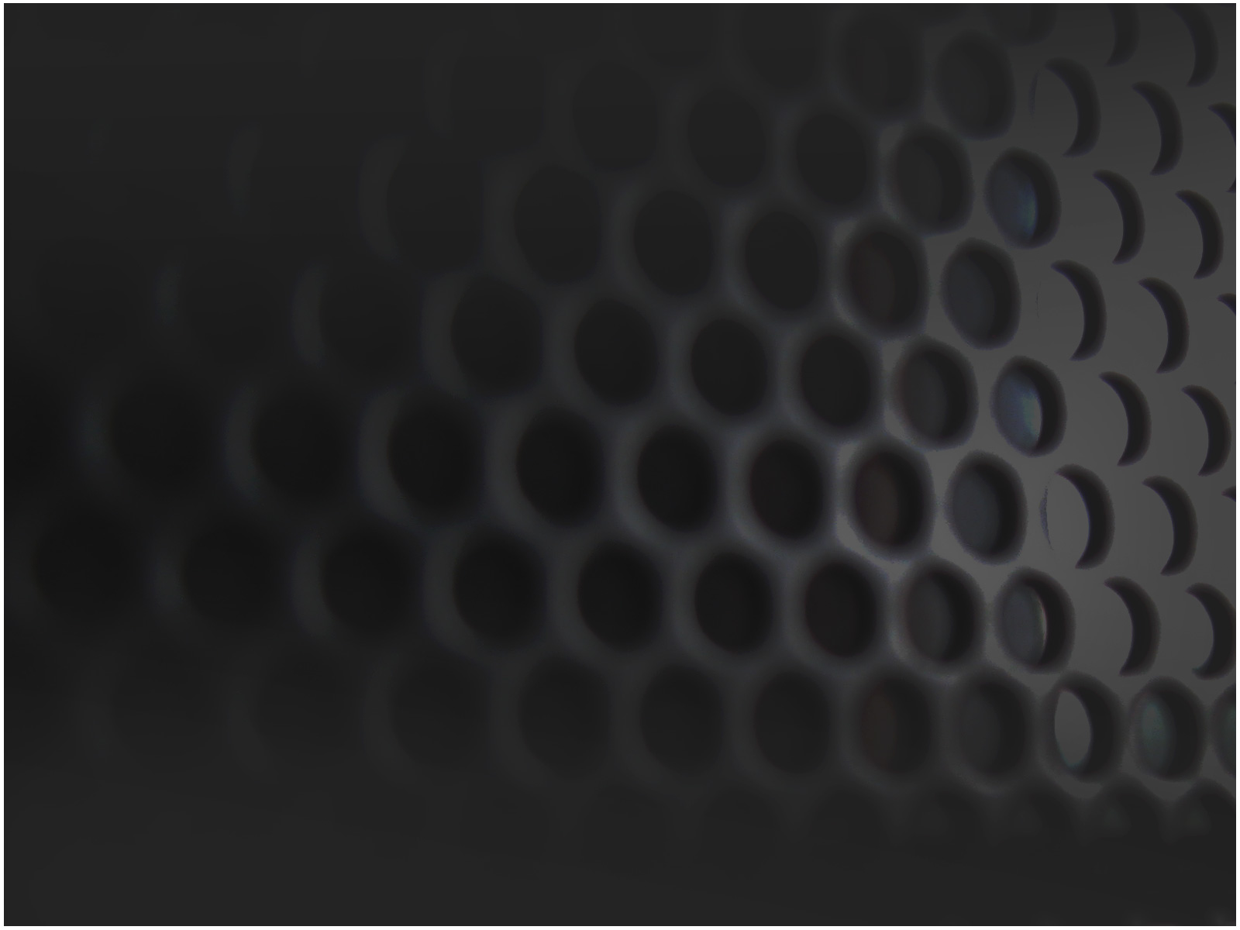
Software Engineering Patterns:
Facade
Kelly Enright

Slide 2
Façade Pattern
Goals:
Applied to group of classes (subsystem)
Provides unified interface to subsystem
Makes subsystem easier to understand and use
Complicated systems are given a pretty “face”

Slide 3
How This Is Accomplished
Design a wrapper class that encapsulates subsystem
This façade contains access to the complexities of the subsystem while remaining fairly simple
Client accesses the façade only

Slide 4
Advantages
Increase portability
Reduce dependencies
Ability to improve security and performance
Simplify
Shield clients from subsystem

Slide 5
Disadvantages
Façade becomes the only access point of subsystem
Might limit some feature and flexibility that knowledgeable users may need

Slide 6
Java Example:
Complex Subsystems
class Memory {
/**
* The memory loads data from certain
* memory locations
*
*
*/
public void load(long position, byte[] data) {
...
}
}
class HardDrive {
/**
* The hard drive handles the reading
* of instructions from memory
*
*
*/
public byte[] read(long lba, int size) {
...
}
}
/* Complex subsystem */
class CPU {
/**
* The CPU handles all the processing
* of instructions
*
*
*/
public void freeze() { ... }
public void jump(long position) { ... }
public void execute() { ... }
}

Slide 7
Java Example:
Façade
/* Facade */
class Computer {
/**
* The Computer acts as an intermediate class
* between the underlying hardware and the user
*
*
*/
private CPU cpu=null;
private Memory memory=null;
private HardDrive hardDrive=null;
public Computer() {
this.cpu=new CPU();
this.memory=new Memory();
this.hardDrive=new HardDrive();
}
public void startComputer() {
cpu.freeze();
    memory.load(BOOT_ADDRESS, hardDrive.read(BOOT_SECTOR, SECTOR_SIZE));
cpu.jump(BOOT_ADDRESS);
cpu.execute();
}
}
/* User/Client */
class User {
/**
* The user or client deals only
* with the computer (namely I/O functions)
* instead of dealing directly with underlying hardware
*
*/
public static void main(String[] args) {
Computer facade = new Computer();
facade.startComputer();
}
}

